Slide 1
Attention Daniel Acuna acuna.io

Slide 2
Seq2seq
The problem with this is that information that happened far in the past gets hard to be encoded in the state space
Activity #1: Explore https://colab.research.google.com/github/keras-team/keras-io/blob/master/examples/nlp/ipynb/addition_rnn.ipynb
Activity #2: Run prediction 42 + 10

Slide 3
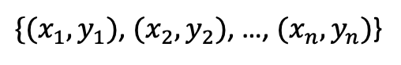
Attention origins
Naradaya-Watson in 1964 [Nadaraya 1964] proposed a way of thinking about regression
$\{{(x}_{1},y_{1})$, ${(x}_{2},y_{2})$, …, ${(x}_{n},y_{n})$}
y
Non-parametric prediction of a new datapoint x’?

Slide 4
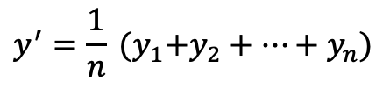
Attention origins
Naradaya-Watson in 1964 [Nadaraya 1964] proposed a way of thinking about regression
$\{{(x}_{1},y_{1})$, ${(x}_{2},y_{2})$, …, ${(x}_{n},y_{n})$}
y
y’
Non-parametric prediction of a new datapoint x’?
$$y^{′}=\frac{1}{n} {(y}_{1}+y_{2}+…+y_{n})$$
x’

Slide 5
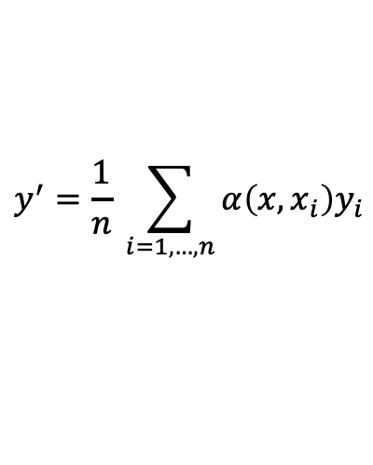
Attention origins
Naradaya-Watson in 1964 [Nadaraya 1964] proposed a way of thinking about regression
$\{{(x}_{1},y_{1})$, ${(x}_{2},y_{2})$, …, ${(x}_{n},y_{n})$}
y
y’
Non-parametric prediction of a new datapoint x’?
$$y^{′}=\frac{1}{n} \sum_{i=1,…,n}{α\left(x,x_{i}\right)y_{i}}$$
x’
Explain alpha(x, xi)

Slide 6
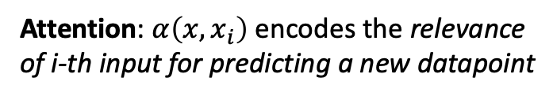
Attention origins
Naradaya-Watson in 1964 [Nadaraya 1964] proposed a way of thinking about regression
$\{{(x}_{1},y_{1})$, ${(x}_{2},y_{2})$, …, ${(x}_{n},y_{n})$}
y
y’
Non-parametric prediction of a new datapoint x’?
$$y^{′}=\frac{1}{n} \sum_{i=1,…,n}{α\left(x,x_{i}\right)y_{i}}$$
x’
Attention: $α\left(x,x_{i}\right)$ encodes the relevance of i-th input for predicting a new datapoint

Slide 7
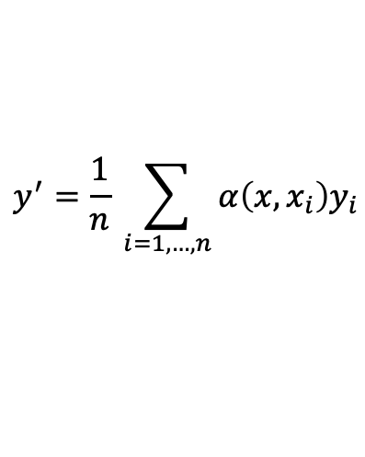
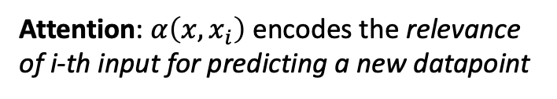
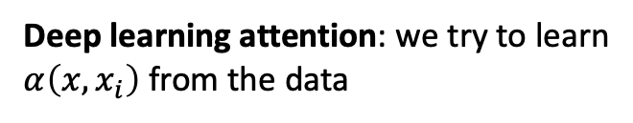
Attention origins
Naradaya-Watson in 1964 [Nadaraya 1964] proposed a way of thinking about regression
$\{{(x}_{1},y_{1})$, ${(x}_{2},y_{2})$, …, ${(x}_{n},y_{n})$}
y
Non-parametric prediction of a new datapoint x’?
y’
$$y^{′}=\frac{1}{n} \sum_{i=1,…,n}{α\left(x,x_{i}\right)y_{i}}$$
Attention: $α\left(x,x_{i}\right)$ encodes the relevance of i-th input for predicting a new datapoint
x’
Deep learning attention: we try to learn $α\left(x,x_{i}\right)$ from the data

Slide 8
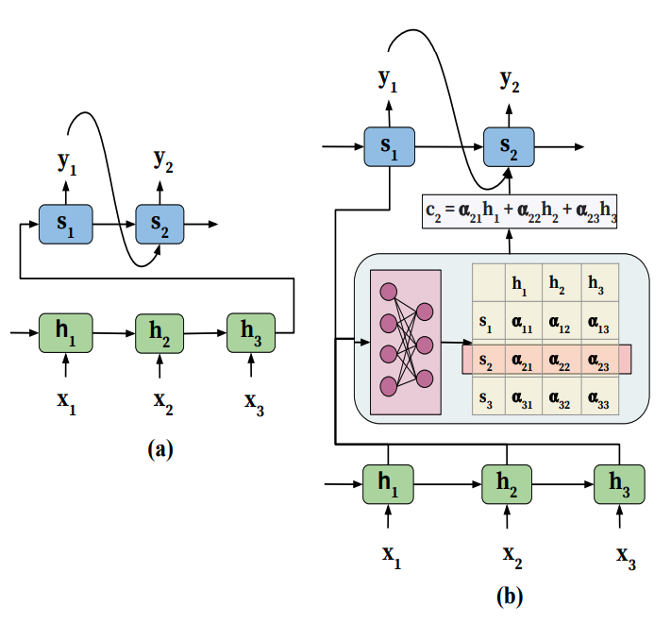
Attention model
Problems:
Encoder has to compress all input information into a single context vector h_{T} (last hidden state), which leads to loss of information
Model is unable to model alignment between input and output, which happens in translation or summarization (a single output should be influence by specific inputs, but context vector cannot do that)
Decoder
Context vector
Encoder
h: hidden state from encode
s: hidden state in decoder

Slide 9
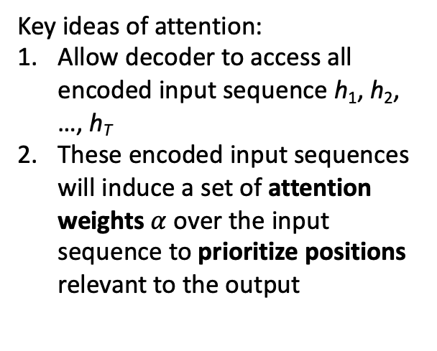
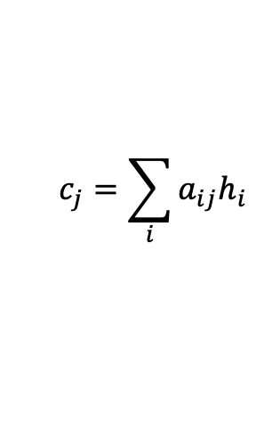
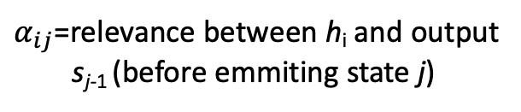
Attention model: context
Key ideas of attention:
Allow decoder to access all encoded input sequence h₁, h₂, …, h_{T}
These encoded input sequences will induce a set of attention weights $α$ over the input sequence to prioritize positions relevant to the output
$α_{ij}$=relevance between h_{i} and output s_{j-1} (before emmiting state j)
$$c_{j}=\sum_{i}{a_{ij}h_{i}}$$
context vector

Slide 10
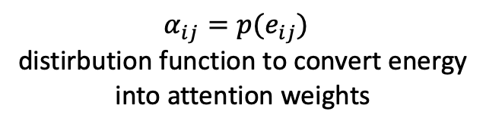
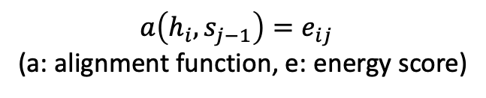
Attention model: attention learning
Attention weight learning: use additional feedforward network
$a\left(h_{i},s_{j−1}\right)=e_{ij}$
(a: alignment function, e: energy score)
$α_{ij}=p(e_{ij})$
distirbution function to convert energy into attention weights
Example functions for p?

Slide 11
Attention model: attention learning
Attention weight learning: use additional feedforward network
$a\left(h_{i},s_{j−1}\right)=e_{ij}$
(a: alignment function, e: energy score)
$α_{ij}=p(e_{ij})$
distirbution function to convert energy into attention weights
Because p and a are differentiable, we can learn those parameters

Slide 12
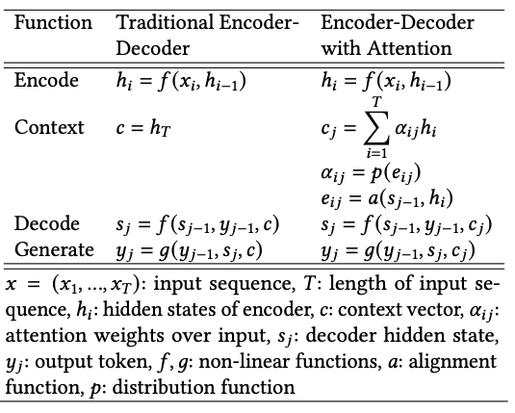
Attention model: math
(Chaudhari et al., 2021)

Slide 13
Generalized Attention Model: KV store
A traditional dictionary contains a set of key-value pairs d[k] => v
How to use a dictionary d? Why is it useful?

Slide 14
Generalized Attention Model: KV store
d[k] => v
Question: How can we implement a dictionary with a matrix operation?

Slide 15
Generalized Attention Model: KV store
d[k] => v
Question: How can we implement a dictionary with a matrix operation?
A Generalized Attention Model uses a continuous dictionary or HashMap where the key is chosen according to a query
The output of the dictionary is the attention to the values

Slide 16
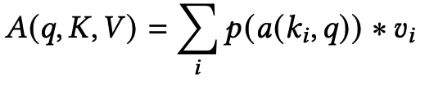
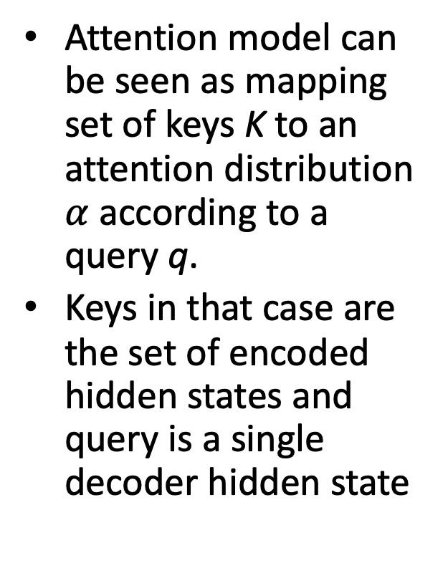
Generalized Attention Model
Attention model can be seen as mapping set of keys K to an attention distribution $α$ according to a query q.
Keys in that case are the set of encoded hidden states and query is a single decoder hidden state

Slide 17
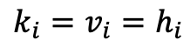
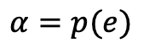
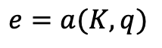
Generalized Attention Model
Generalized Attention Model
$$e=a(K,q)$$
$$α=p(e)$$
In initial article introducing attention (Bahdanau, 2015),
it used
$$k_{i}=v_{i}=h_{i}$$
But these can be arbitrary

Slide 18
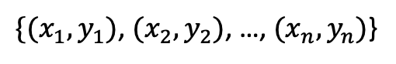
Generalized Attention Model
$\{{(x}_{1},y_{1})$, ${(x}_{2},y_{2})$, …, ${(x}_{n},y_{n})$}
y’
$$y^{′}=\frac{1}{n} \sum_{i=1,…,n}{α\left(x,x_{i}\right)y_{i}}$$
In this example, query is x, keys are x_{i}, and values are y_{i}
x’

Slide 19
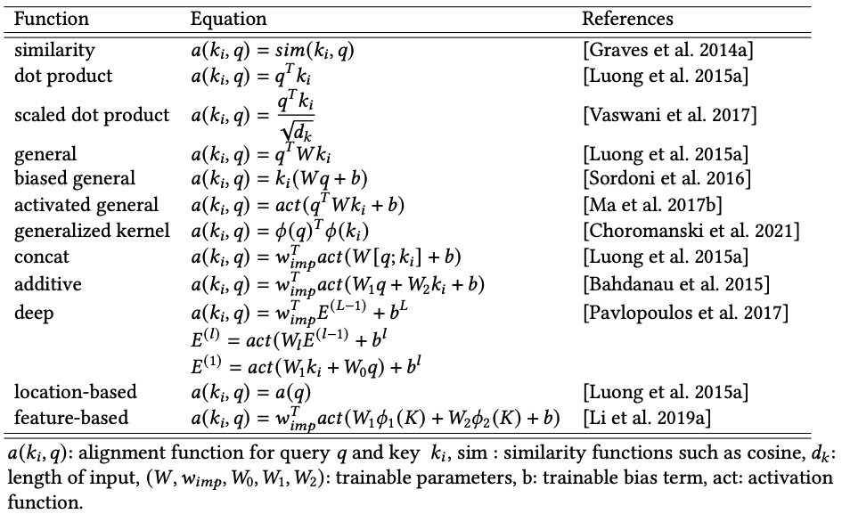
Combining keys and query
The alignment function a and distribution function p determine how keys and queries are combined to produce weights
One family of alignment uses comparison between key and query
Another family uses combinations of keys and query (e.g., concatenate)
Some assume that key and query are in the same space; others don’t

Slide 20
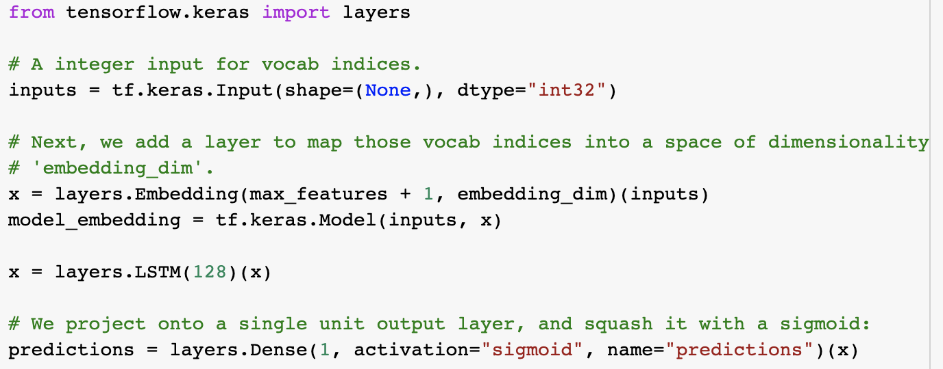
Activity
Self attention on LSTM
Explore interpretability of model
Traditional model

Slide 21
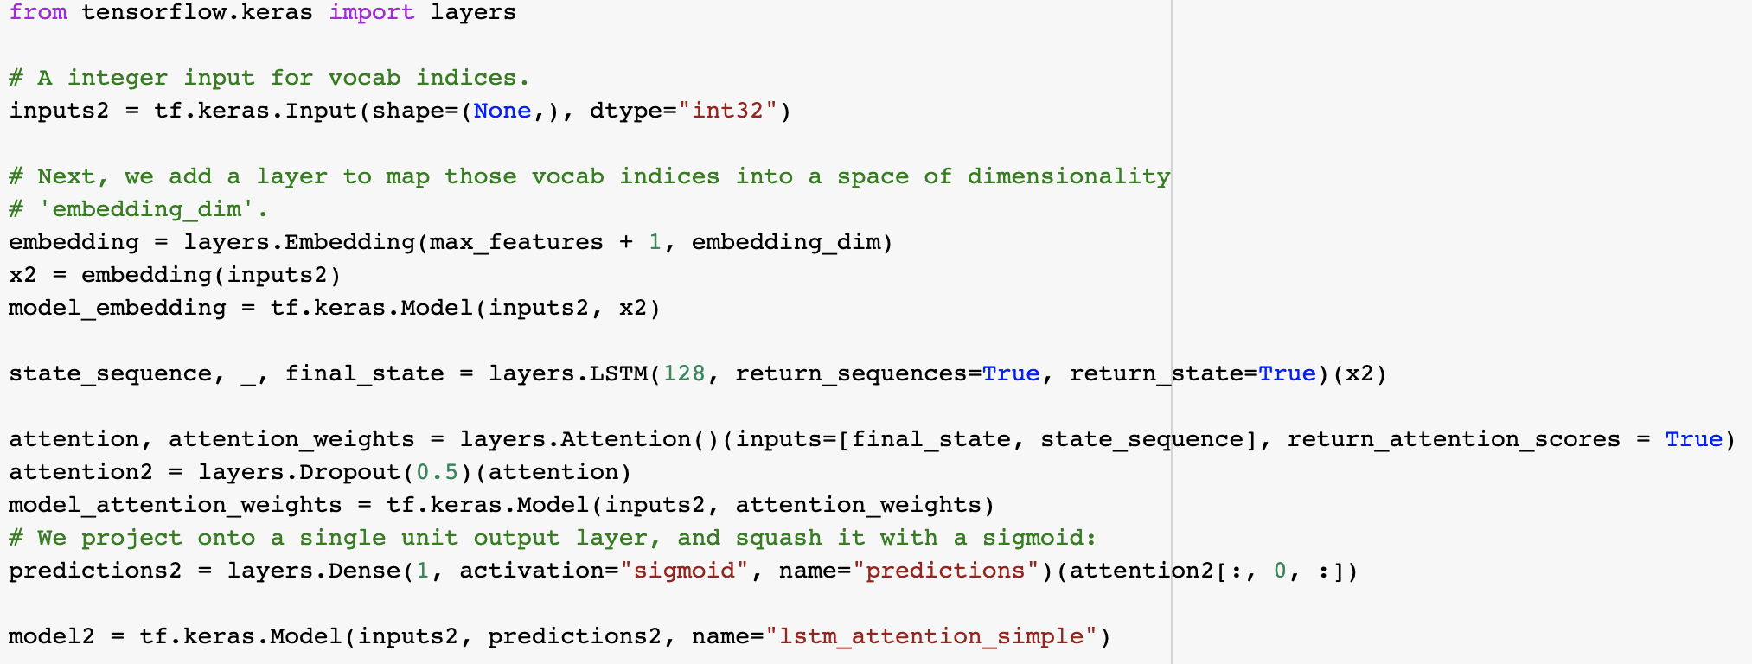
Activity (2)
Attention layer in Keras: https://keras.io/api/layers/attention_layers/attention/

Slide 22
Activity (3)
https://colab.research.google.com/github/daniel-acuna/applied_deep_learning/blob/master/RNN/lstm_with_selfattention.ipynb
Activity #1: Is traditional LSTM better than LSTM with attention?
Acitivy #2: interpret self-attention weights

Slide 23
Distribution functions
Map alignments to attention scores
Examples are sigmoid and softmax
Sigmoid and softmax assume that all values are non-zero. However, attention should be sparse
Some variants have sparsity built in: sparsemax and sparse entmax

Slide 24
Attention differences: Number of sequences
In seq2seq, there is a clear distinction between keys (inputs) and query (states of encoder)
This kind of attention is called distinct because the key values are separated
$$e=a(K,q)$$

Slide 25
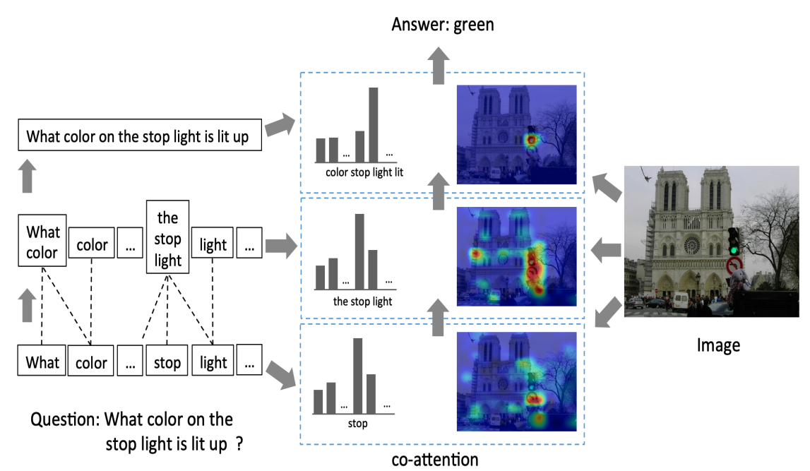
Attention differences: Number of sequences (2)
For some problems, however, there could be multiple inputs (e.g., visual question answering)
This kind of attention is called co-attention

Slide 26
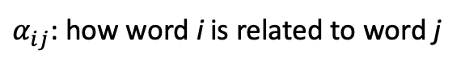
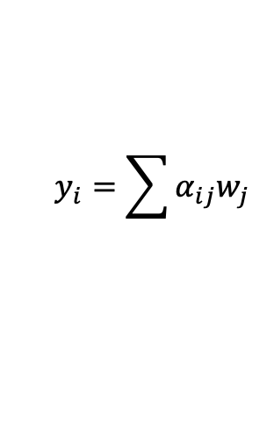
Attention differences: Number of sequences (3)
Other problems do not have “outputs”, but might still benefit from attention.
This kind of attention is called self-attention
This can be useful when an element of a sequence can use elements of the sequence itself
{w₁, w₂, …, w₅}
$$y_{i}=\sum{α_{ij}w_{j} }$$
{y₁, y₂, …, y₅}
word inputs (e.g., embeddings)
attention
output of self-attention
$α_{ij}$: how word i is related to word j

Slide 27
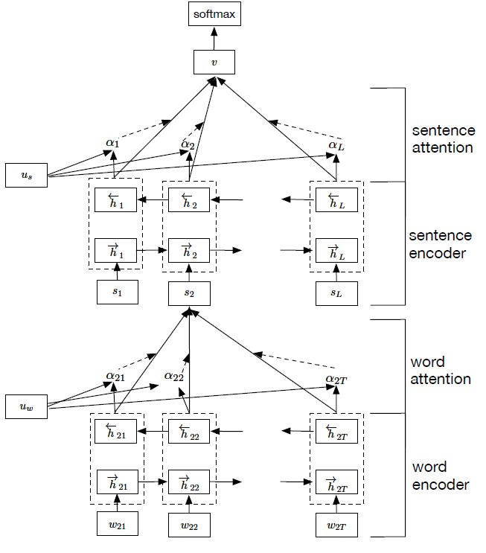
Abstraction layers
Attentions can be computed only for the input space. This type of attention is called single-level.
Attention can also be created in multiple layers to capture increasing multi-level abstractions
“Hierarchical Attention Model"(HAM) (Yang et al., 2016)

Slide 28
Abstraction layers (2)
The work by Lu et al. 2016 combines co-attention (text and image) and multi-level of attention (word, phrase, setence)

Slide 29
Number of positions
We might want to focus on many positions of the input simultanously. This is called soft attention
However, we might want to appy an sparse selection of inputs using sampling. This is called hard attention
Other work (Luong et al., 2015) used global attention (e.g., soft attention) and local attention around the focused points of the input

Slide 30
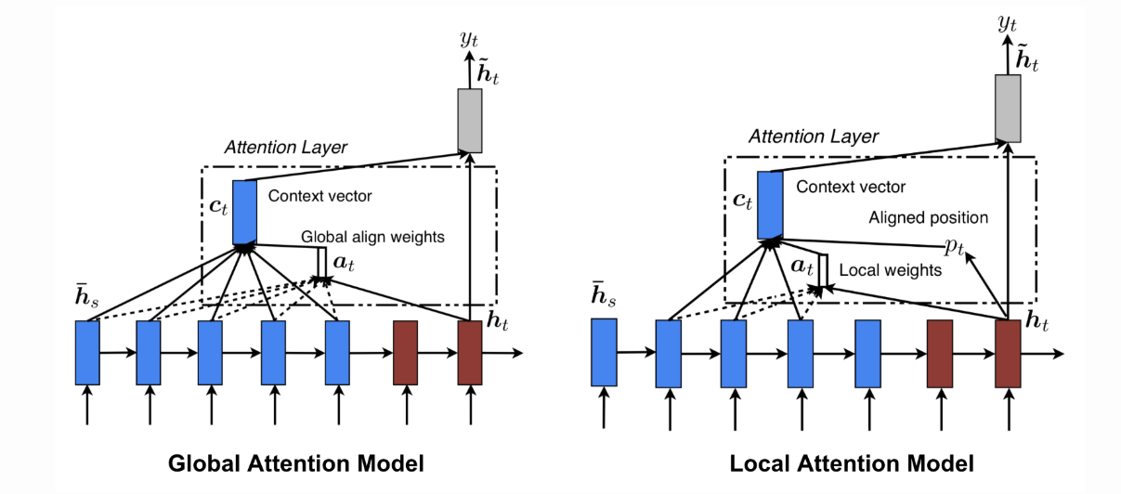
Number of positions
Other work (Luong et al., 2015) used global attention (e.g., soft attention) and local attention around the focused points of the input

Slide 31
Number of representations
Traditional attention model: single feature representing the input sequence
Multi-representational attention model: multiple features representing the input sequence.
Multi-dimensional attention model: weights are introduced for each dimension of input embedding

Slide 32
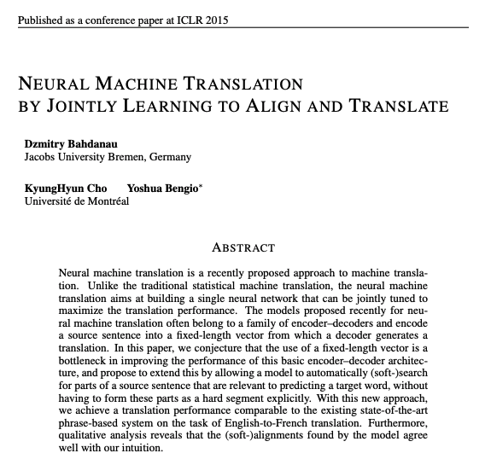
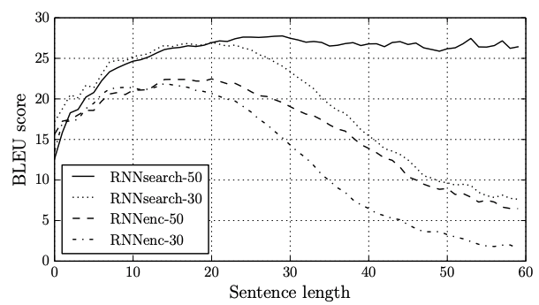
Applications: Natural Language Processing

Slide 33
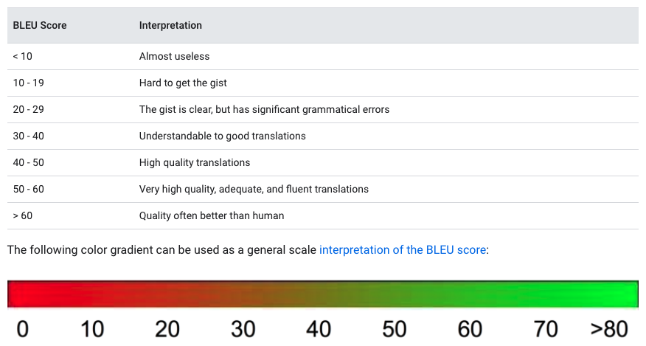
BLEU score
Proposed by IBM [Papineni et al, 2002]
BLEU (BiLingual Evaluation Understudy) is a metric for automatically evaluating machine-translated text
The BLEU score is a number between zero and one that measures the similarity of the machine-translated text to a set of high quality reference translations
https://cloud.google.com/translate/automl/docs/evaluate#bleu

Slide 34
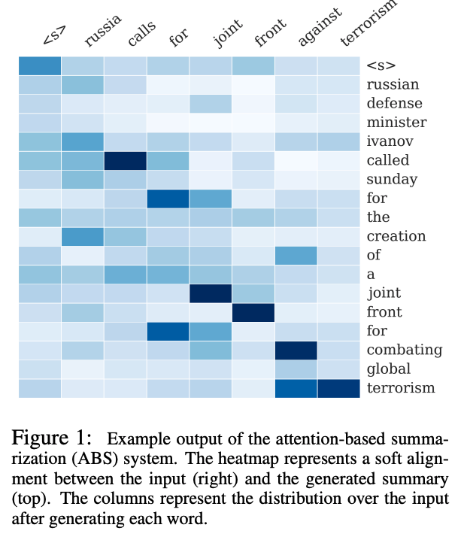
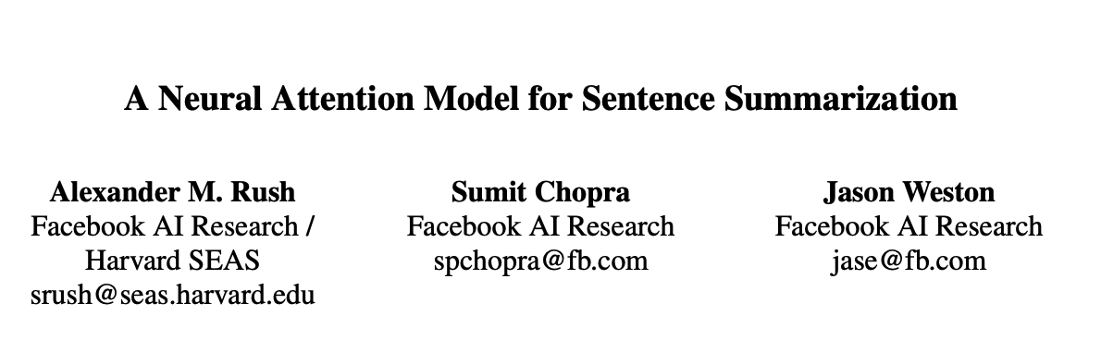
Applications: question answering
Abstractive summarization

Slide 35
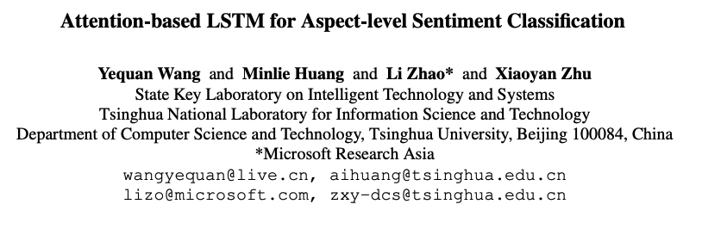
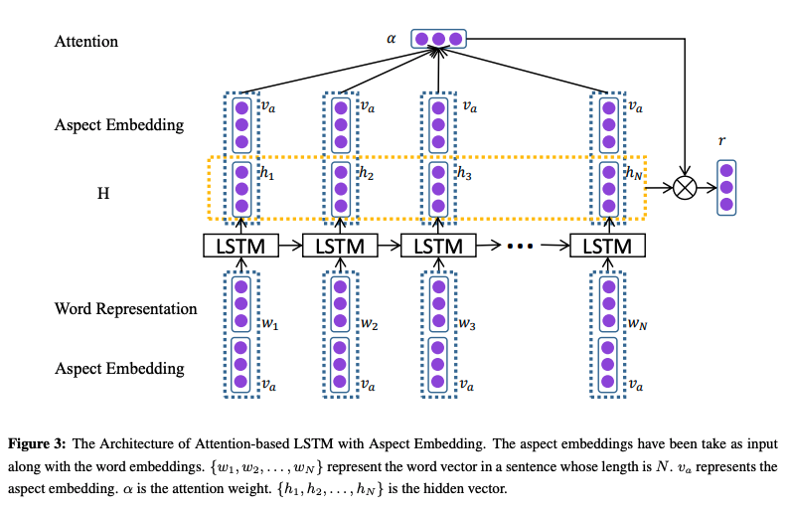
Applications: sentiment analysis

Slide 36
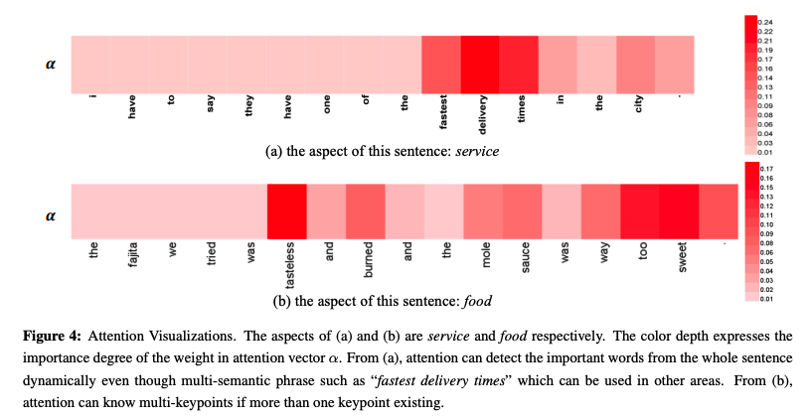
Applications: sentiment analysis

Slide 37
Applications: pre-trained models
Transformers (next class): parallel processing of text without recurrance
Transforms rely only on attention (self attention)
Many models: Transformer-XL, BART, BERT, RoBERTa, ALBERT, GPT-2, GPT-3

Slide 38
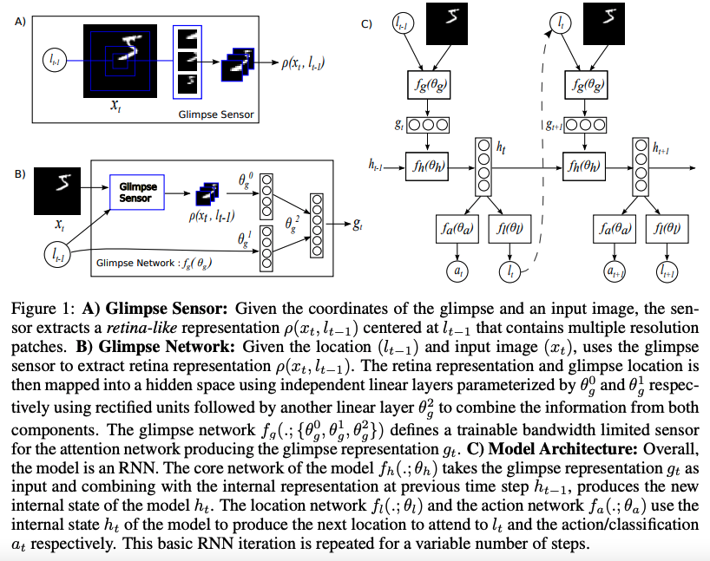
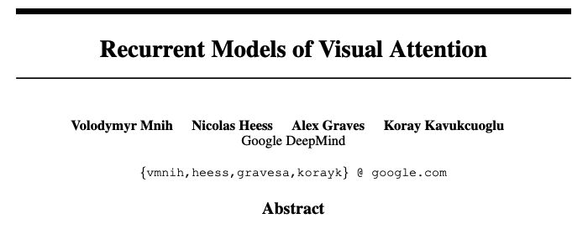
Computer Vision: Image Classification
Method reduces time because it tells the CNN where to pay attention to
It was able to process much bigger images

Slide 39
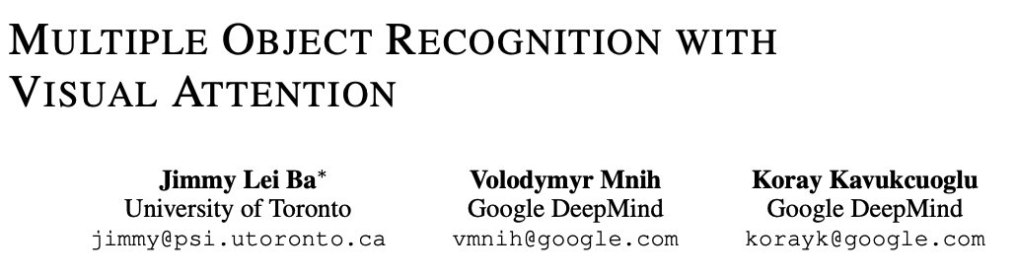
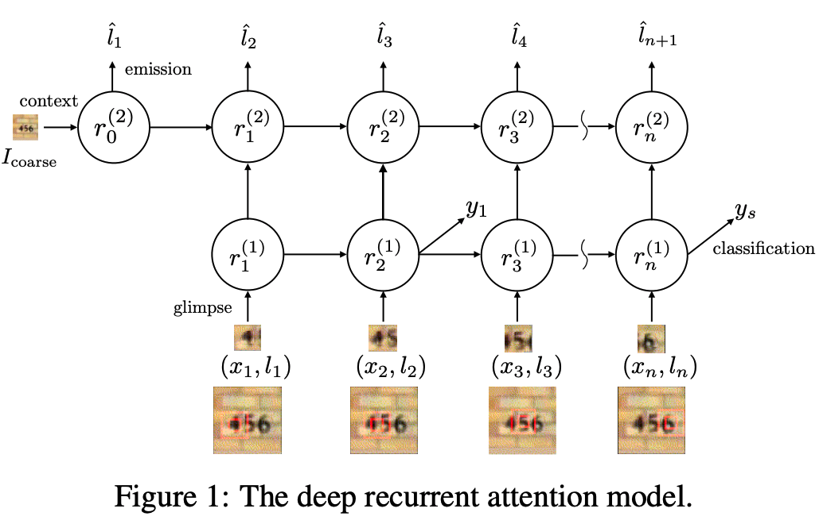
Computer Vision: Object Detection
It can detect multiple objects in an image by detecting them sequentially

Slide 40
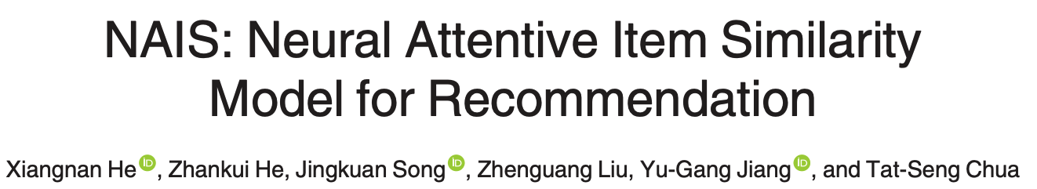
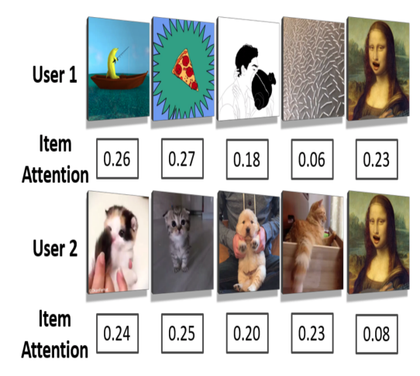
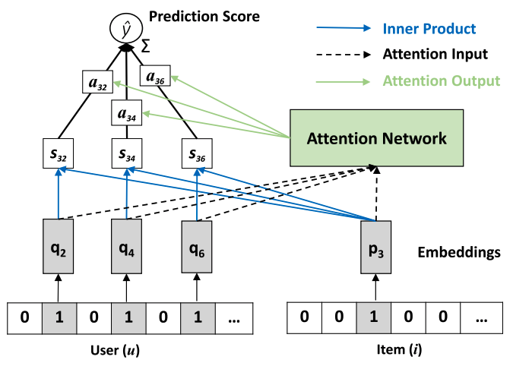
Recommendation systems

Slide 41
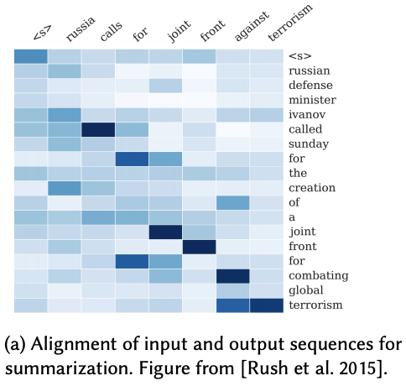
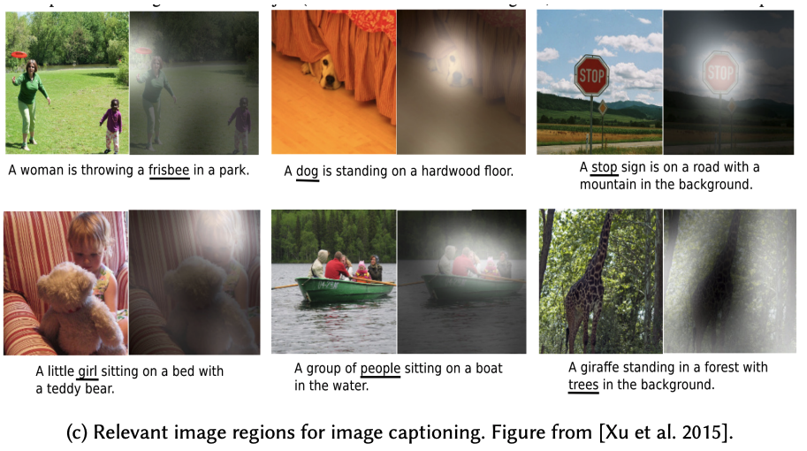
Attention: Intepretability
The attention values are excellent sources of interpretability: where is the model paying attention to?

Slide 42
Conclusion
Attention has lead to significant gains in performance
Attention also helps with interpretability
Attention also helps with computational performance
New developments in NLP are mostly based on pure attention based architectures such as the Transformer

